Slide 1

Numerical ODE
不正经讲师：理科宅Hunt

Slide 2
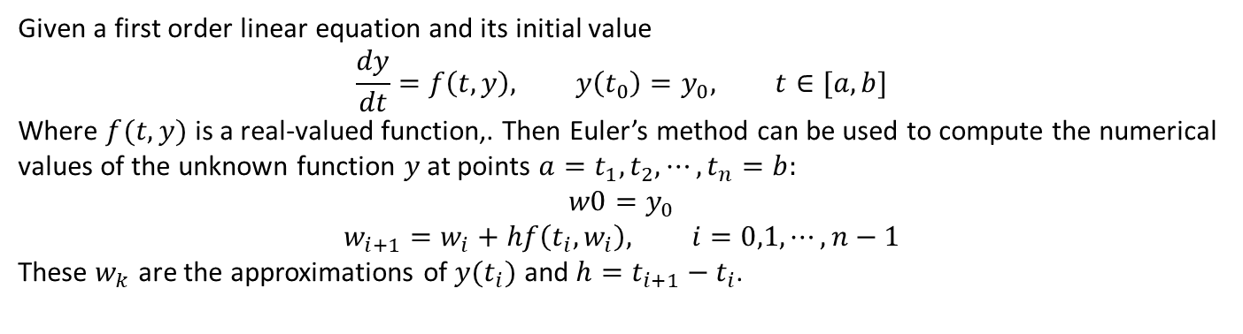
1st order method – Euler’s method
Given a first order linear equation and its initial value
$$\frac{dy}{dt}=f\left(t,y\right), y\left(t_{0}\right)=y_{0}, t∈[a,b]$$
Where $f(t,y)$ is a real-valued function,. Then Euler’s method can be used to compute the numerical values of the unknown function $y$ at points ${a=t}_{1}, t_{2},⋯,t_{n}=b:$
$$w0=y_{0}$$
$$w_{i+1}=w_{i}+hf\left(t_{i},w_{i}\right), i=0,1,⋯,n−1$$
These $w_{k}$ are the approximations of $y(t_{i})$ and $h=t_{i+1}−t_{i}$.

Slide 3
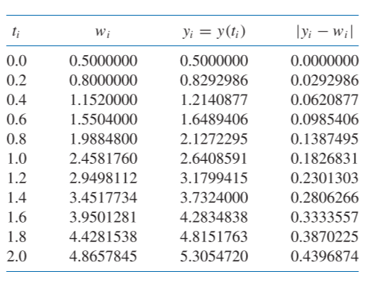
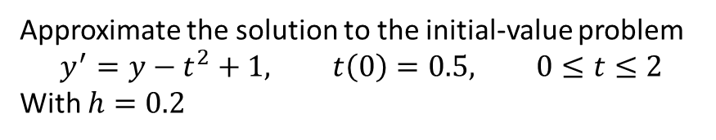
Example
Approximate the solution to the initial-value problem
$$y^{′}=y−t^{2}+1, t\left(0\right)=0.5, 0≤t≤2$$
With $h=0.2$

Slide 4
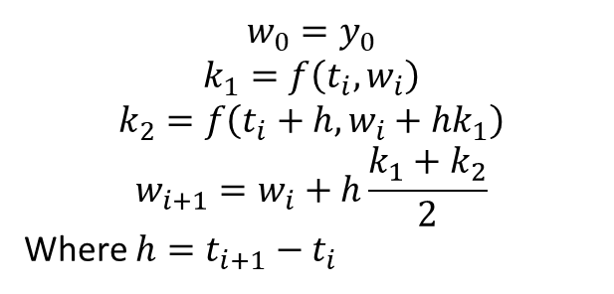
2nd order method –Modified Euler
$$w_{0}=y_{0}$$
$$k_{1}=f\left(t_{i},w_{i}\right)$$
$$k_{2}=f\left(t_{i}+h,w_{i}+hk_{1}\right)$$
$$w_{i+1}=w_{i}+h\frac{k_{1}+k_{2}}{2}$$
Where $h=t_{i+1}−t_{i}$

Slide 5

2nd order method – Mid-point
$$w_{0}=y_{0}$$
$$k_{1}=f\left(t_{i},w_{i}\right)$$
$$k_{2}=f\left(t_{i}+\frac{h}{2},w_{i}+\frac{h}{2}k_{1}\right)$$
$$w_{i+1}=w_{i}+h(k_{1}+k_{2})$$
Where $h=t_{i+1}−t_{i}$

Slide 6
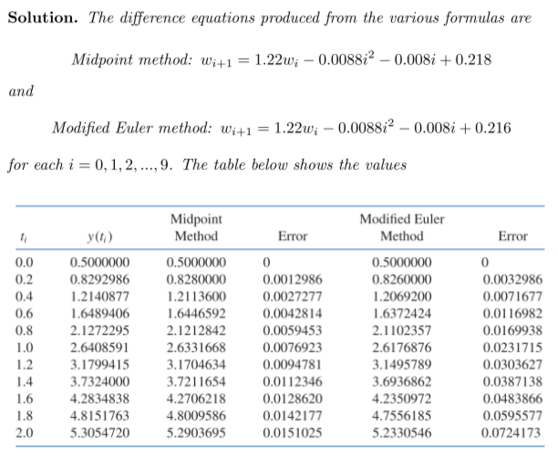
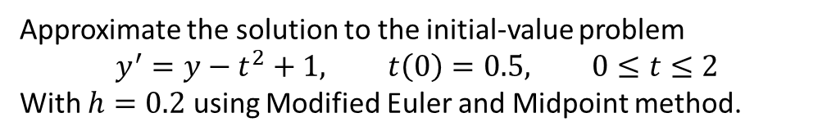
Example
Approximate the solution to the initial-value problem
$$y^{′}=y−t^{2}+1, t\left(0\right)=0.5, 0≤t≤2$$
With $h=0.2$ using Modified Euler and Midpoint method.

Slide 7
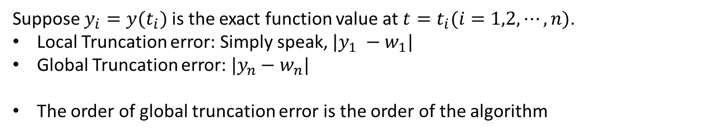
Global and Local Truncation error
Suppose $y_{i}=y(t_{i})$ is the exact function value at $t=t_{i}(i=1,2,⋯,n)$.
Local Truncation error: Simply speak, $|y_{1} −w_{1}|$
Global Truncation error: $|y_{n}−w_{n}|$
The order of global truncation error is the order of the algorithm

Slide 8
Conclusion - 总结
Euler’s method (1st order)
Midpoint, Modified Euler (2nd order)

